Slide 1
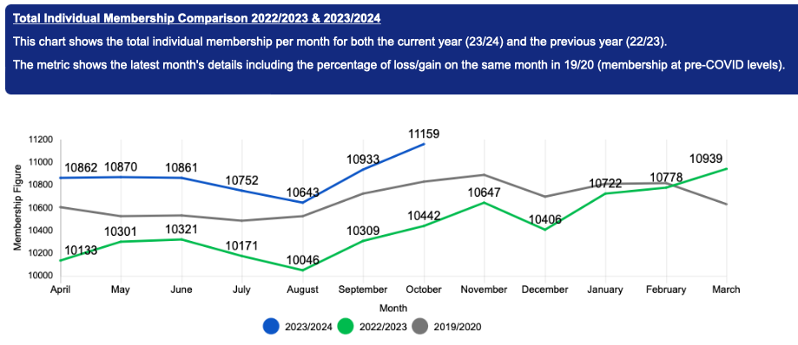
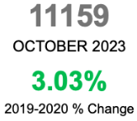
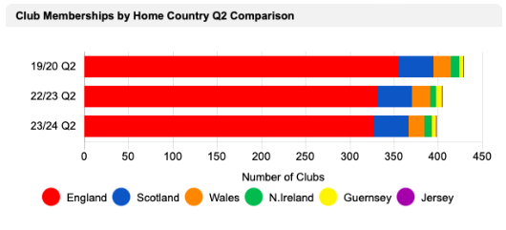
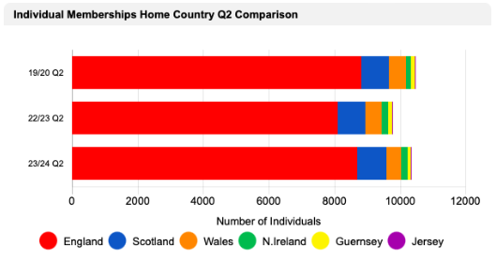
BF UPDATE
ENGLAND NUMBERS end of OCT 23
Individual – 8681 (11159)
Club – 326 (398)
*Figures here taken from Q2 the last day in September 2023
Notes:
Feeling of clubs working closer and haring best practice – positive vibe

Slide 2
BF UPDATE
SAFEGUARDING
SafeGuard new system for BF welfare courses, it is a personal learning journey that will take members through courses and CPD depending on their role within our community - https://www.britishfencing.com/safeguard-explained/
New system for DBS Checks - https://www.britishfencing.com/change-in-process-for-dbs-checks/
COMMUNITY
Environmental Survey
British Fencing (‘BF’) is fully committed to minimising the environmental impact of its activities through adopting sound principles, implementing good practice, and by continuous improvement in environmental performance.
https://www.britishfencing.com/environmental-sustainability-survey/
GB LEAGUE - https://www.britishfencing.com/gb-league-zone/
Community Discussion Events – https://www.britishfencing.com/community-discussion-events/
EVENTS
Wheelchair Fencing World Cup - https://www.britishfencing.com/wheelchair-fencing-world-cup-2024/
Dates 2024 - *Please note that changes to dates could occur
British Senior Championships (Including Team Championships) - 27th-28th April 2024
British Youth Championships - 4th-6th May 2024
British Open Championships and GB Cup - 13th-14th July 2024
Cadet and Junior National Championships - 14-15th September 2024
https://www.britishfencing.com/bf-event-dates-2024-save-the-dates/
Notes:
Feeling of clubs working closer and haring best practice – positive vibe

